Slide 1
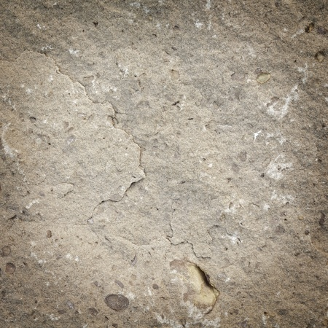
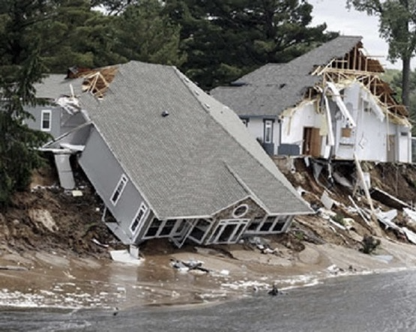
The Wise and Foolish Builders
Foolish
Wise
Matthew 7:21, 24-27; Luke 6:46-49
Dr. David Martin • Amman International Church AmmanChurch.org • BibleStudyDownloads.org

Slide 2
1
2

Slide 3
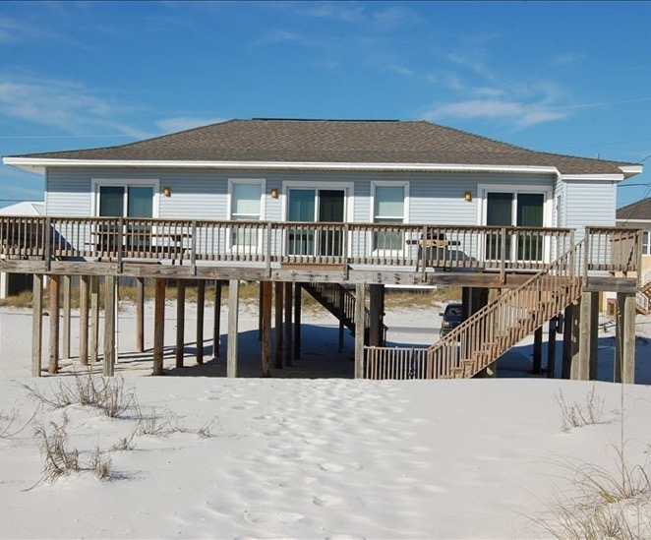
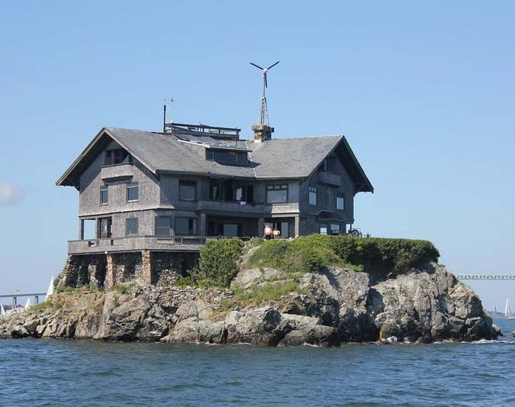
1
2

Slide 4
The Wise and Foolish Builders
Matthew 7:21, 24-27; Luke 6:46-49

Slide 5
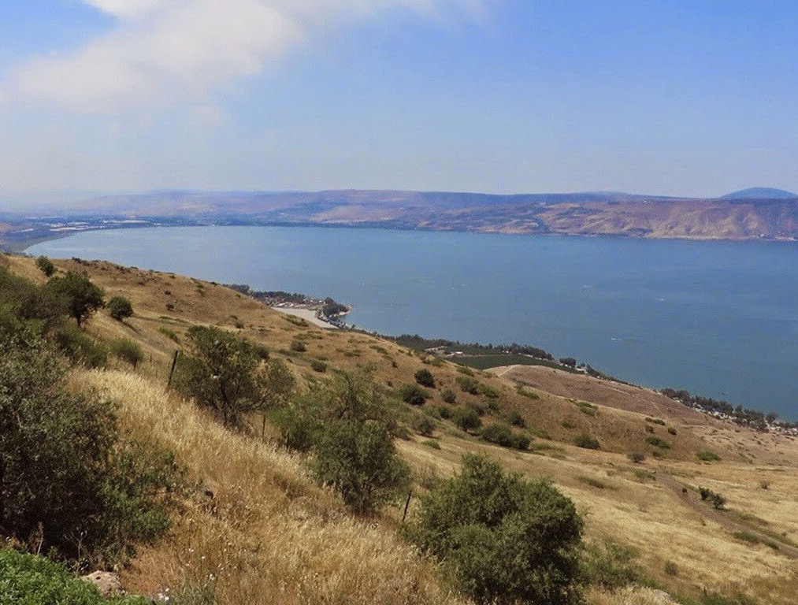
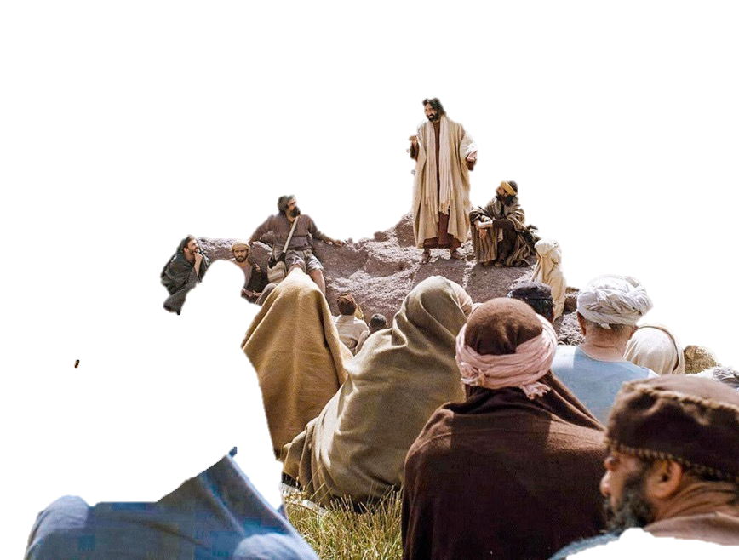
The sermon on the mount
Huge crowds were coming to Jesus (Luke 6:17)
(Matt. 7:21, 24-27; Luke 6:46-49)
The Sea of Galilee

Slide 6
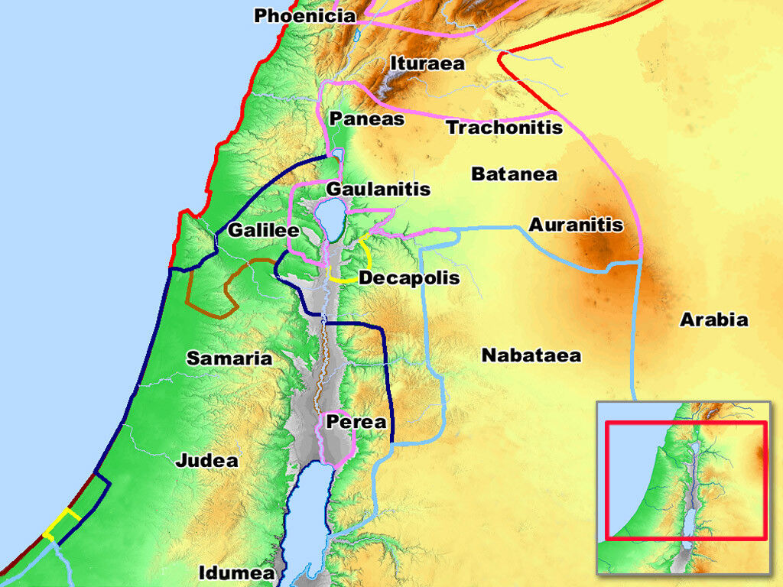

Slide 7
The sermon on the mount
Huge crowds were coming to Jesus (Luke 6:17)
Jesus gave authoritative teaching on entering the Kingdom of God and its lifestyle
Sermon conclusion: Parable of two builders
The Issue: What is your response to Jesus’ teaching?
The Sea of Galilee

Slide 8
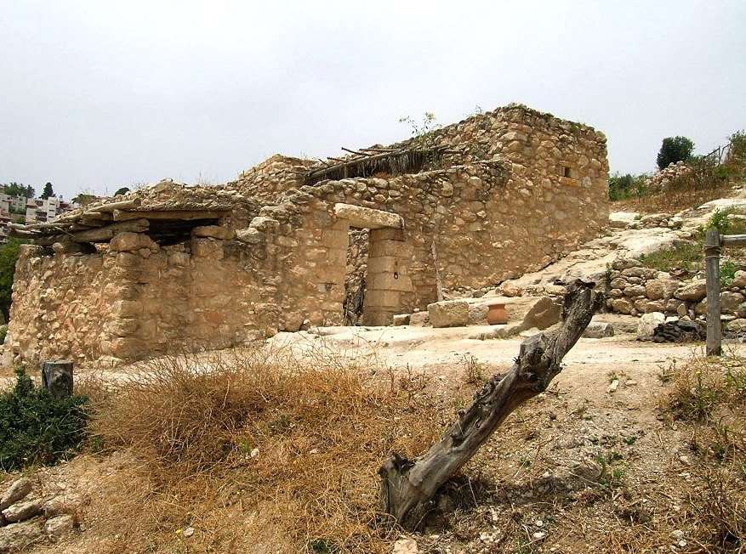
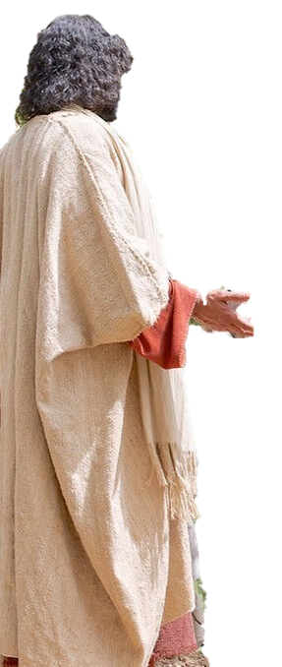
Jesus shares from his vocation
Mark 6:3; Matthew 13:55
Jesus was a tekton (craftsman)
✓Wood
✓Stone
✓Metal
Nazareth Village

Slide 9
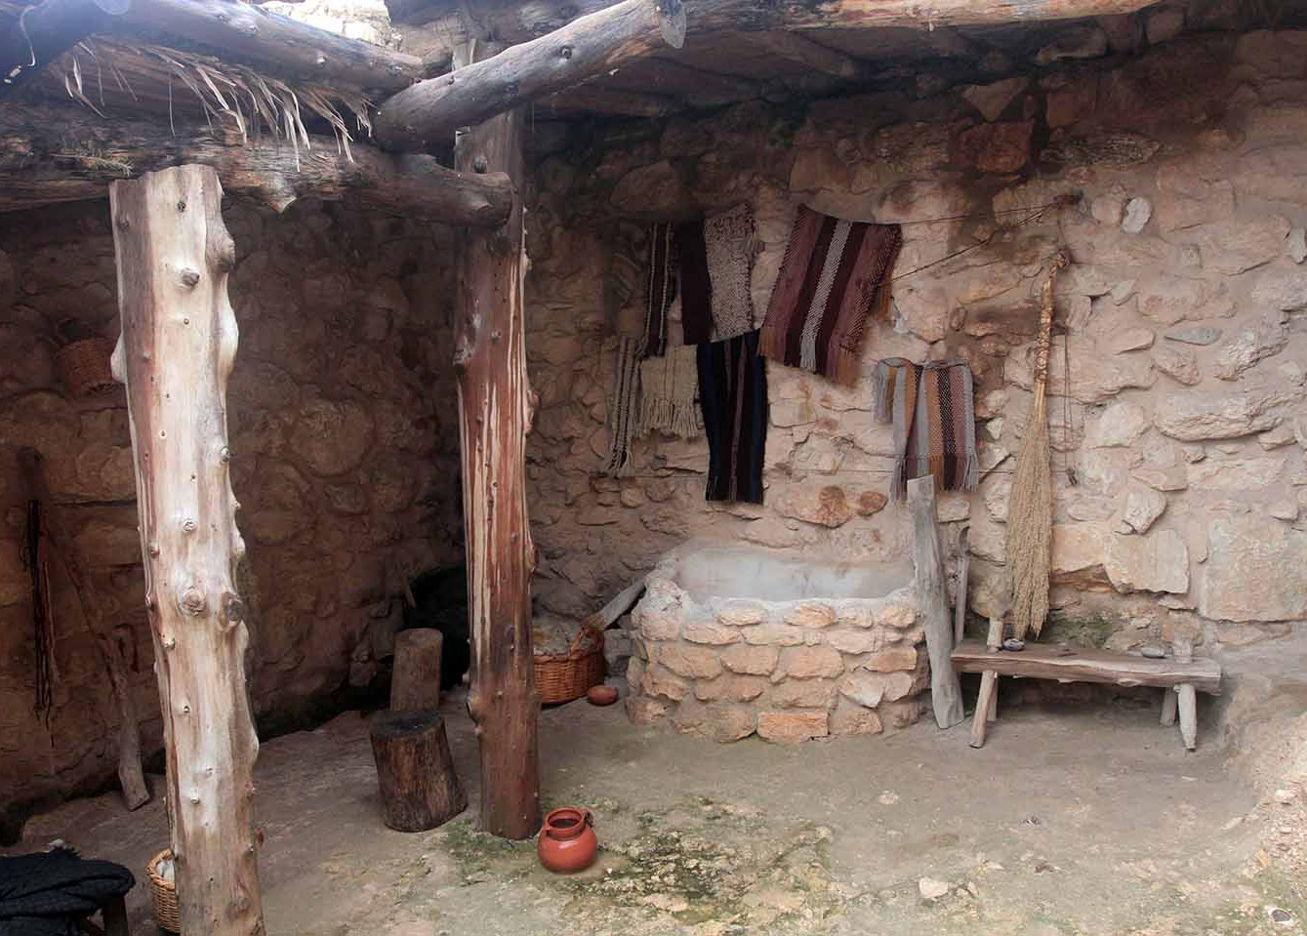
1st Century Building
✓Made of mud, baked bricks, or stone
✓Building was a long, slow process
✓Foundations required digging to bedrock
✓The roof was wooden beams with thatching (Mark 2:3-4)
✓It needed to be finished before winter rains came
Nazareth Village

Slide 10
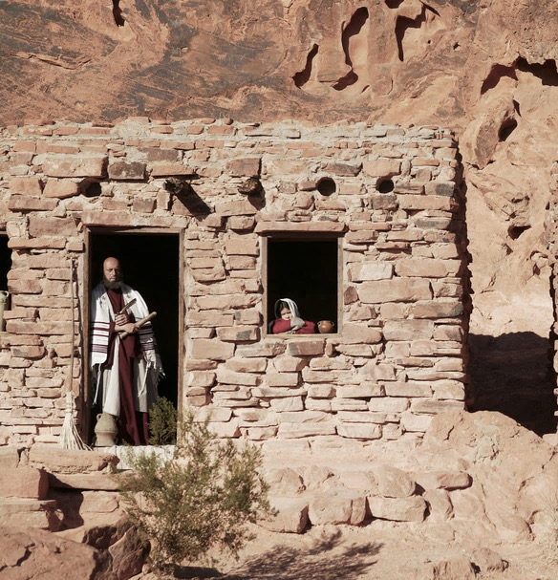
The wise builder
The builder =
Comes to Jesus
Hears Jesus’ words
Applies Jesus’ words
The house =
One’s life (built day by day)
Storms =
Difficulties Disappointments Persecutions
Final judgment
Foundation =
Jesus and His Word

Slide 11
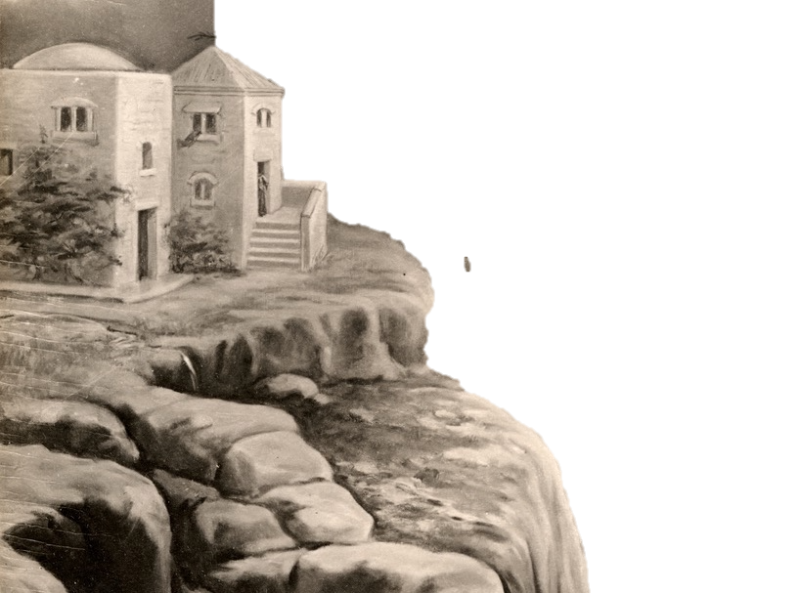
Salvation through Christ
Living by the Word of God

Slide 12
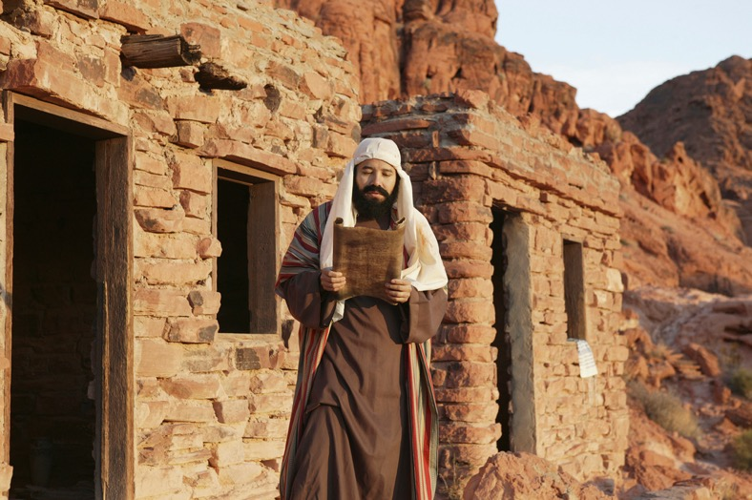
The foolish builder
The builder =
Has been exposed to Jesus
Has heard Jesus’ words
Doesn’t believe Jesus’ words
The house =
One’s life (built day by day)
Storms =
Difficulties Disappointments Final judgment
Foundation =
Anything but Jesus and His Word

Slide 13
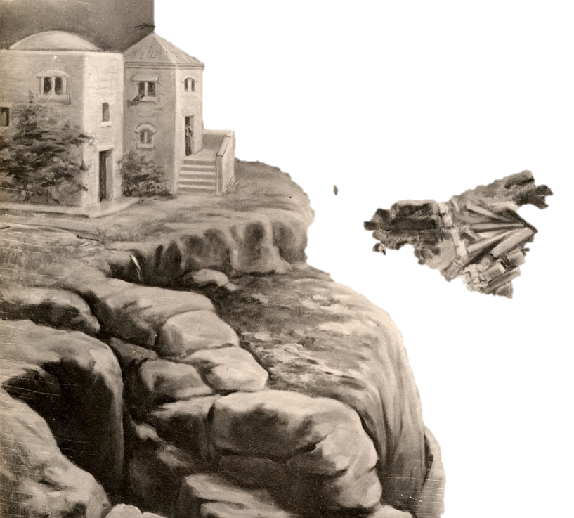
Destruction is sure

Slide 14
What kind of builder are you?
Foolish
Wise
Built on man’s beliefs and/or works
Built on Christ’s person and His Word

Slide 15
Come, hear, and apply God’s Word daily (James 1:22; Acts 17:11)
What do we learn?

Slide 17
Come, hear, and apply God’s Word daily (James 1:22; Acts 17:11)
1. Make Jesus your foundation for life by receiving His salvation (1 Cor. 3:10-15).
Ignore teaching on salvation = eternal ruin
2. Crown Jesus as the Lord of your life by committing to do His Word/will (Luke 6:46).
What do we learn?
Notes:
Note by Rick Griffith:
We need a word of clarification about, "1. Make Jesus your foundation for life by receiving His salvation (1 Cor. 3:10-15)." Since Paul addressed only Christians in 1 Cor 3 with the focus on works (not unbelievers) being burned up, we must emphasize that no one can lay any other foundation than Jesus Christ (1 Cor 3:11). This refers to salvation, which the Corinthian church already had. But they were building with useless materials that would burn up. Even more serious than this is to ignore teaching on salvation and suffer eternal fire.

Slide 18
How to Live Under the Lordship of Jesus Christ
Entertainment
Money
Friends
Work
Leisure
Love life
Are there rooms in your life that are “off limits” to the Lord?
Don’t forget: 1 Cor. 6:19-20

Slide 20
Parables of Jesus • BibleStudyDownloads.org
Get this presentation for free!
Notes:
Parables of Jesus (pj) link

